Slide 1


Problem Statement :- Automatic Assessment of Pavement Condition based on road Images
Problem Code:- MK199
Domain bucket :- Software - Web App development
Organization:- Ministry of Rural Development
Team :- CliffHangers
Github repository link :- https://github.com/AbhiDhariwal/NC_SVCE_MK199_CliffHangers

Slide 2
Proposed Solution
We are using Object Detection and Classification Model/ Image Processing Techniques
Using two different State of the Art Models (most accurate Faster RCNN or fastest YOLO) for Object Detection.
The detection result will be our final output with either fast approach or with best accuracy depending on the use.
The result will be sent for further classification and identification of level and type of road damage.
Detailed Report will be generated and can be viewed both online Web Portal and offline Excel sheet with automated sharing (or Mailing) option.
Upon Classification it will also suggest approximate cost so more accurate tender can be issued.
Further a Lite model will be made available so that it can be integrated into Android/ IOS app like “Meri Sadak” so that it can directly send report to respective authority thus helping in fast decision making.
GPS Tagging will tell the exact location of the pothole or cracks so that finding them will be easy for workers.

Slide 3


Work Flow
Road issue Detection
Model
Working
Category Classification
Model
Working
Category of issue found in Cropped image
Sets of Road Images with Road ID or video of the particular Road
Pool of Images of each Road with unique Image ID
One image from the pool
Cropped Images where road issue are found
Category
Category
One image from the pool of images
Category
Road1
Road2
Cropped parts from the image with unique Cropped ID
Categories of defects found in cropped parts
Sets of images for different roads

Slide 4
Let's Visualize the Normal Workflow

Slide 5
`
We classify the damage level
- Damage level is identified for each defect found in image
User Uploads Image
- add basic details like state,village,contact details
After Processing details uploaded to website
- Officials can check details on website using PC/ mobile
- can search image processed and its details using image id
In Mobile App
Website
Detection Identify defect and its location in the image
- crop the defects from the image and send it to classification
PCI index calculated
- according to the high/ medium/ low damage PCI index is calculated
Processing at Server

Slide 6
Now the Alternative Flow

Slide 7
`
We classify the damage level
- Damage level is identified for each defect found in image
User Uploads Image
- add basic details like state,village,contact details
After Processing details uploaded to website
- Officials can check details on website using PC/ mobile
- can search image processed and its details using image id
Website
Detection Identify defect and its location in the image
- crop the defects from the image and send it to classification
PCI index calculated
- according to the high/ medium/ low damage PCI index is calculated
In Mobile App
Processing at Server

Slide 8
Benefits of alternative flow -
Reduce load on server
Reduce time in overall process
Drawbacks-
SSD models in used in mobile phones
Trade off between Accuracy vs Time

Slide 9
Mix of above two approaches
If defects are identified in the mobile app then it will directly send location of defects for further classification of damage level.
(defects with high confidence value from the model)
If no defects are found then we can send it to main flow to server for detecting defects.
(defects with low confidence value from the model)

Slide 10
Django based WebApp
To display all the results in real-time
WebApp live on : http://amanchande.co/
Login details
Test ID - hello@email.com
Test password - hello123

Slide 11
Key Points
All the processing and results will be updated on WebApp in real-time.
The results will be visible to authorised users only.
Currently we have two roles: Ministry and Contractor.
Users will be assigned the roles only after successful verification by admin.
Ministry will be able to view status of any road.
Contractors can only view the status of roads assigned to them.

Slide 12
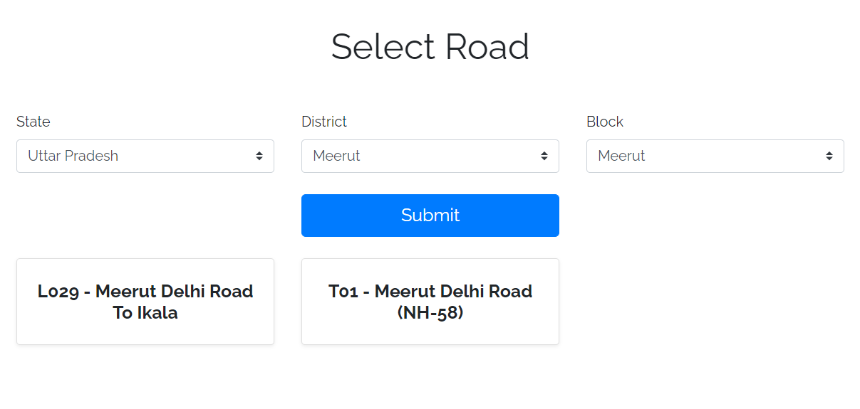

Slide 13
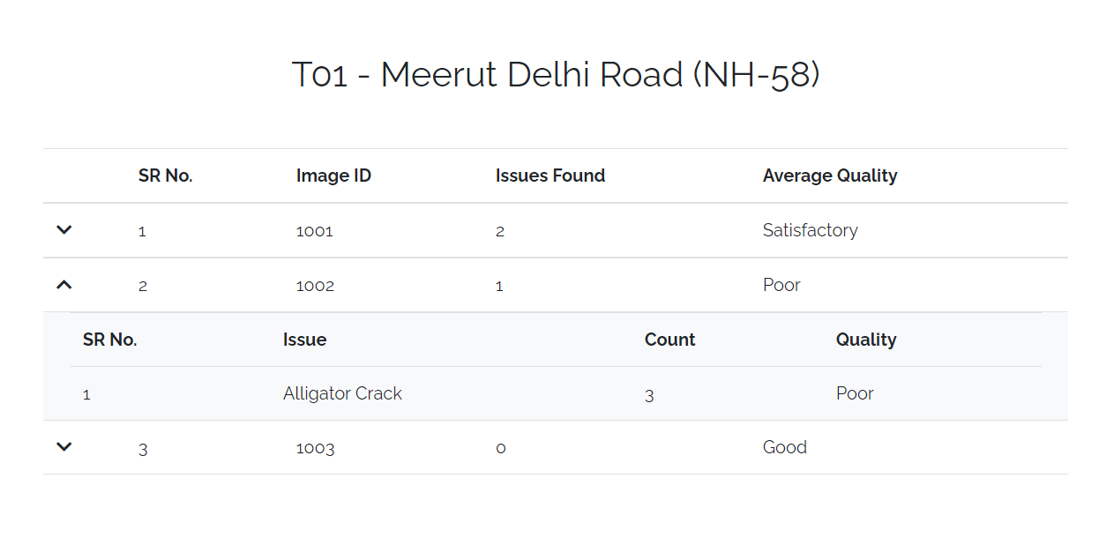

Slide 14
Large Files are present in the given link below:
Including Video demonstration of our solution.
https://drive.google.com/drive/u/1/folders/1R8GK71cc16CAI8Hs-M8DrNDWarJXVmeu
Training details and the machine used for training
https://docs.google.com/document/d/1dEr2vvDFOspA4Si9wKAXWgILzruchdyBQ2Y7bvm7U3c/edit
Visit Website:- Click Here
Login details:-
UserID:- hello@email.com
Password:- hello123
Role :- Ministry

Slide 15
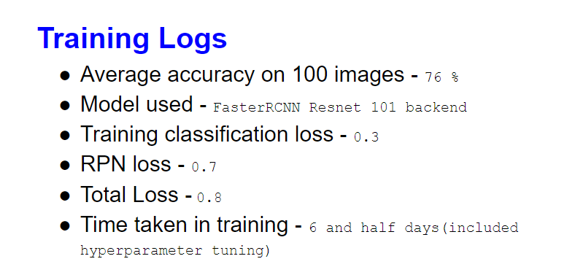
Accuracy can be further improved as major dataset is not available for Indian roads and with more training and hyperparameter Tuning

Slide 16
The formula we are using in our solution to obtain the Pavement Condition Index -

Slide 17
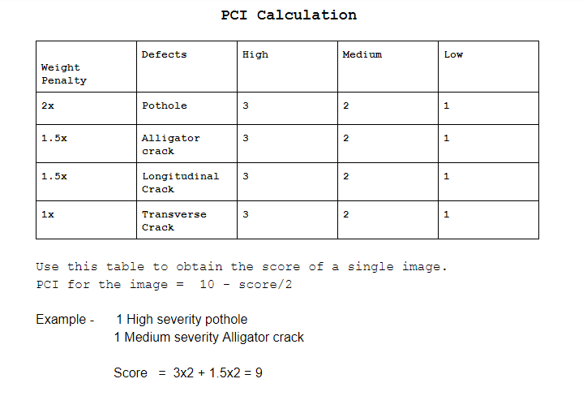

Slide 18
